Slide 1


ENVIRONMENT PERCEPTION SYSTEM FOR SMART VEHICLES
Team No.: 01
Advisor and Customer: Dr. Muhammad Bilal
Co-Advisor: Dr. Mohammed Shahzad Hanif
Winter 2022 Intake

Slide 2



W22 Team-01
Responsible for the Image Rectification, Distance Detection, and Optimization.
M1 — Khalid M. Al-Dahasy
Responsible for the Birds Eye View, Object Detection, and Image Undistortion.
M2 — Saad A. Al-Jehani
Responsible for the Hardware Implementation, User Interface, and 3d Design and printing.
M3 — Bander S. Al-Sulami

Slide 3
Table of contents
01-
02
03
04
05
06
Introduction-
Problem Statement
Project Objectives
Project Design Specifications
Alternatives and baseline design
Validation Experiments

Slide 4
Table of contents
07
08
09
10
Implementation and final product
Results
Impact analysis
Conclusion
01
Introduction

Slide 5
01
Introduction

Slide 6
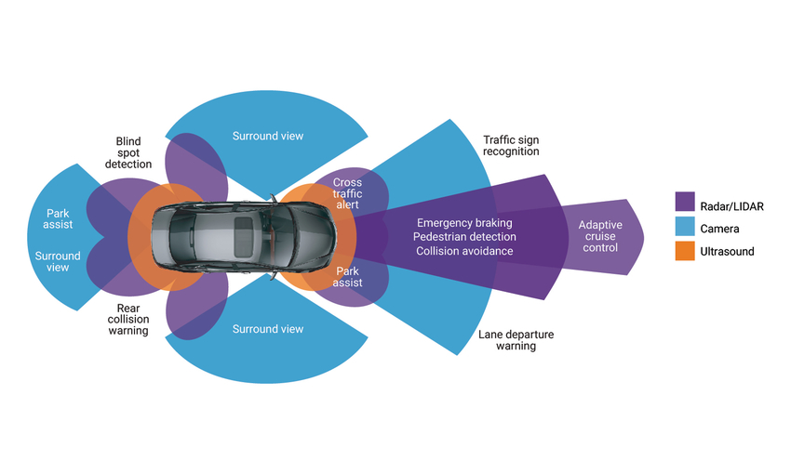
Introduction
Background
An environment perception system for smart vehicles is a system that uses sensors to detect objects in the environment and algorithms to process the data and identify cars, pedestrians, and animals. It can also detect their distance and speed, making the driver aware of any blind spots. As technology advances, the importance of the environmental perception system increases.
ADAS Types [1]

Slide 7
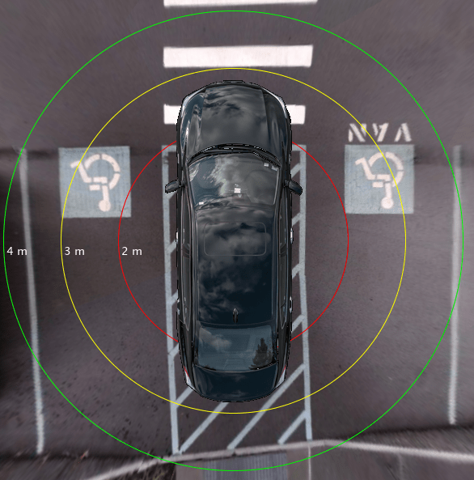
Introduction
Terminologies
blind spot is an area where you cannot see well. It can be a physical spot on your eye or a road.
Bird's eye view is view of the car from above as it looks if a camera is directly above the car.
Bird’s eye view [2]

Slide 8
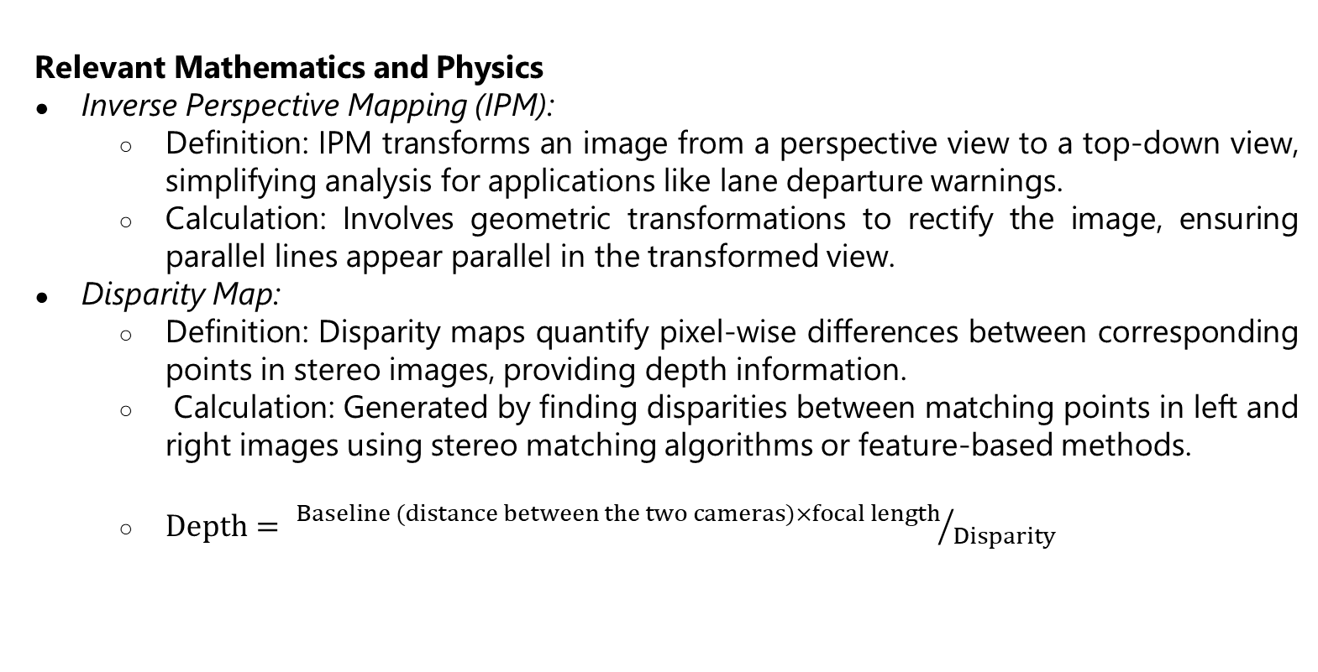
Introduction
Relevant Mathematics and Physics
Inverse Perspective Mapping (IPM):
Definition: IPM transforms an image from a perspective view to a top-down view, simplifying analysis for applications like lane departure warnings.
Calculation: Involves geometric transformations to rectify the image, ensuring parallel lines appear parallel in the transformed view.
Disparity Map:
Definition: Disparity maps quantify pixel-wise differences between corresponding points in stereo images, providing depth information.
Calculation: Generated by finding disparities between matching points in left and right images using stereo matching algorithms or feature-based methods.
$Depth= {Baseline (distance between the two cameras)×focal length}/{Disparity}$
02
Problem Statement

Slide 9
Introduction
Relevant Mathematics and Physics
AASHTO formula for stopping distance : s = (0.278 × t × v) + v² / (254 × (f + G))
where:
s – Stopping distance in meters
t – Perception-reaction time in second
v – Speed of the car in km/h
G – Grade (slope) of the road, expressed as a decimal. Positive for an uphill grade and negative for a downhill road
f – Coefficient of friction between the tires and the road. It is assumed to be 0.7 on a dry road and between 0.3 and 0.4 on a wet road.
02
Problem Statement

Slide 10
02
Problem Statement

Slide 11
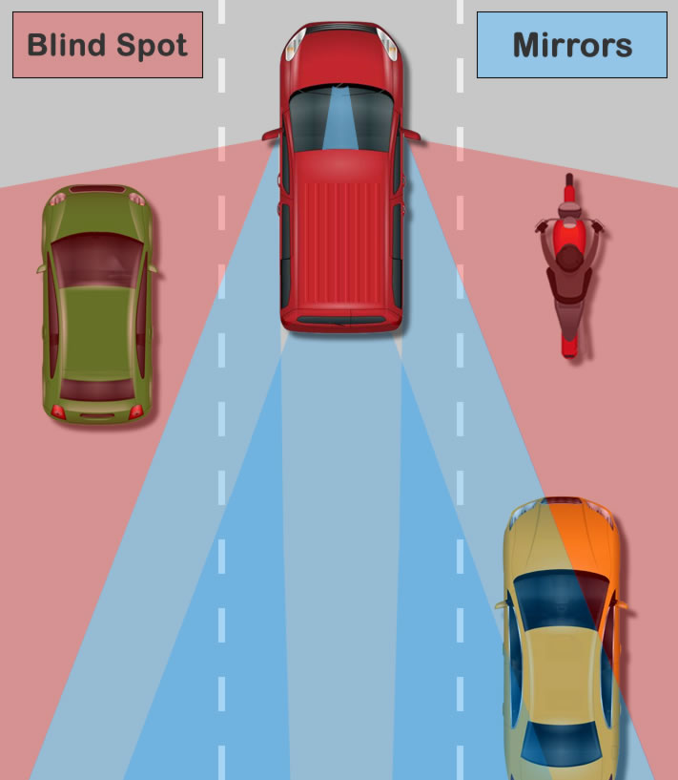
Problem Statement
Using the four Ws method:
What is the problem?
Mirrors do not give enough information about the car's surroundings and can not perceive blind spots.
Who is experiencing the problem?
Car drivers.
Where does the problem present itself?
During parking, and when changing lanes.
Why does it matter?
Not knowing if a car is in the blind spot might cause accidents and endanger people lives.
Car blind spots [3]

Slide 12
Drivers can’t see blind spots when using mirrors during parking or when changing lanes, and that puts their lives in danger.
03
Project Objectives

Slide 13
03
Project Objectives

Slide 14
Project Objectives
Lower-level Objectives
Provide the driver with a detailed distortion-free view of the vehicle surrounding free from any blind spots on a screen installed on the dashboard
Provide information about the relative distances of all the objects within proximity of the vehicle
Provide a parking-friendly view for similar and difficult parking scenarios in tight spots
Achieve real-time performance sufficient for comfortable driving
Notes:
First, lower-level objectives must be met by finishing the project.
And they need to be specific, measurable, achievable, relevant, and time bound.

Slide 15
Project Objectives
Higher-level (Strategic) Objectives:
Make cars safer, especially from accidents caused by collisions from blind spots
Enhance the surrounding view to make driving easier for people uncomfortable with a limited mirror view
Kickstart indigenous development of ADAS technology in KSA for the upcoming age of smart cars
04
Project Design Specifications
Notes:
Higher-level, or strategic objectives are objectives with a large impact and
by completing the project these objectives are one step closer to being achieved.

Slide 16
04
Project Design Specifications

Slide 17
Relevant Engineering Standards
Relevant Engineering Standards | No.
IEC 61810-1:2015 standard applies to electromechanical elementary relays for incorporation into low voltage equipment | 1
ANSI/SAE J563 standard governs the design and specifications of vehicle cigarette burners. | 2
The ISO 5725 for distance measurement guidelines | 3
USB 2.0 standard used to know the bandwidth limitation of the four cameras. | 4

Slide 18
Musts
Provide a distortion-free visual feed with at least 81° vertical field-of-view, covering the vehicle’s blind spots
Provide a user-friendly visual to depict the respective distances of surrounding objects within a 23 meters (braking distance at 70 km/h) radius with an accuracy of at least 90%.
Provide a bird’s eye view for 3 meters around the vehicle to assist while parking in tight spots and parallel parking.
Visual updates should be at least at 10 fps for a flicker-free, smooth, and comfortable view.

Slide 19
Wants
Record all the visual clues to assist in accidental insurance claims
Provide a segmented view with people, cars, pavements, and roads using an appropriate coloring scheme
Provide audio notifications

Slide 20
Assumptions
Environmental conditions are conducive to sensor operation. i.e., heavy rain, fog or pitch-dark conditions are not encountered.
Appropriate sensors can be purchased within the budgetary and time limits.
The proof-of-concept system can be made without exhaustively testing on all types of vehicles.

Slide 21
Constraints
The system can operate on a maximum of 12V DC.
Budget does not exceed 6000 SAR
05
Alternatives and baseline design

Slide 22
05
Alternatives and baseline design

Slide 23
Alternatives and baseline design
Table 1 : Alternative Designs
Functions | Alternatives
 | Alternative 1 | Alternative 2 | Alternative 3
Provide a visual feed covering the blind spots. | Few fisheye (wide angle) cameras | Few fisheye (wide angle) cameras | Few fisheye (wide angle) cameras.
Detect distances of near objects. | LIDAR | Stereo Camera | RADAR
Provide a bird-eye view. | 3D Dual-Fusions | Inverse Perspective Mapping (IPM) | Inverse Perspective Mapping (IPM)
Processes input data to depict useful information. | Jetson | Jetson | Jetson
Display information. | Screen. | Screen. | Screen.
Store visual recording. | Cloud memory | SD memory | Cloud memory
Object detection. | 3D Dual-Fusions | MMLAB LIGA-Stereo | 3D Dual-Fusions
Provide information as audio. | Speaker. | Speaker. | Speaker.
Bus communication. | USB | USB | USB
Material for mounting sensors. | Bracket. | Suction mount. | Drill hole on the exterior of the car.

Slide 24
KT decision analysis​
Table 2 : KT decision analysis​
Alternatives: |  | 1: Lidar based | 2: Stereo-Camera | 3: Radar-based
Musts | Provide a distortion-free visual feed with at least 81° vertical field-of-view, covering the vehicle’s blind spots. | GO | GO | GO
 | Provide a user-friendly visual to depict the respective distances of surrounding objects within a 23-meter radius with an accuracy of at least 90% | GO | GO | GO
 | Provide a bird’s eye view for 3 meters around the vehicle to assist while parking in tight spots and parallel parking. | GO | GO | GO
 | Visual updates should be at least at 10 fps for a flicker-free, smooth, and comfortable view. | GO | GO | GO
Wants | Weight out of 10 | Score out of 3
Record all visual feeds from the previous hour, to assist in accidental insurance claims | 5 | 1 | 3 | 1
Provided a segmented view with people, cars, pavements, and roads using an appropriate coloring scheme. | 8 | 3 | 2 | 1
Provide audio notifications. | 10 | 3 | 3 | 3
 |  | 59 | 61 | 43

Slide 25
Pugh’s method​
Table 3 : Pugh’s method​​
Criteria | Importance | DATUM | 1: Lidar based | 2: Stereo-Camera | 3: Radar-based
Cost | 3 (Extremely important) | 3000 | -1 (worse than DATUM) | 1 (better than DATUM) | 0 (similar to DATUM)
Ease of installation | 3 (Extremely important) | May need professional personnel for installation. | 0 (similar to DATUM) | 1 (better than DATUM) | 0 (similar to DATUM)
Effective for 3D detection | 1 (Normal) | Can detect various types of objects. | 1 (better than DATUM) | 0 (similar to DATUM) | -1 (worse than DATUM)
Effective for Bird's eye view | 3 (Extremely important) | 3-meter bird's eye view. | 1 (better than DATUM) | 1 (better than DATUM) | 1 (better than DATUM)
Effective for detecting distance | 3 (Extremely important) | Can detect with 90% accuracy, within 23 meters. | 1 (better than DATUM) | 1 (better than DATUM) | 1 (better than DATUM)
The constant effect at night and different weather conditions | 1 (Normal) | Affected. | 0 (similar to DATUM) | 0 (similar to DATUM) | 1 (better than DATUM)
Computation load on processer. | 2(very important) | Well within Jetson nano capabilities. | -1 (worse than DATUM) | 0 (similar to DATUM) | -1 (worse than DATUM)
Total |  |  | 2 | 12 | 4

Slide 26
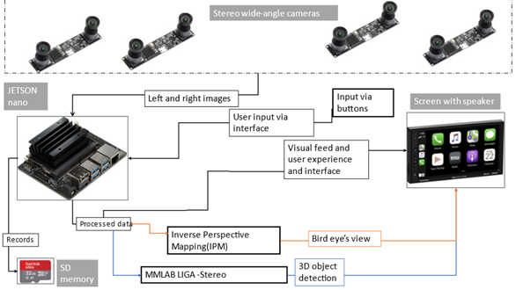
Baseline design
Block Diagram

Slide 27
Maturing Baseline Design​
Number of Cameras and FOV needed: At least 4 cameras with at least 90-Degree Field of view to cover the 360-Degree of the car.
Algorithm Needs: CPU and GPU provided by the Jetson nano fits the needs.
Power Source: According to ANSI/SAE J563 cars would have 12 Volts source. Use adapter for 5 Volts.
User experience: Needs push buttons for user input. Display perspective as user chooses.
Improvements:
Using a more efficient object detection algorithm, the Yolov3-tiny.
Changing buttons or push buttons to using a keypad for a neater look.
.
06
Validation Experiments

Slide 28
06
Validation Experiments

Slide 29
Validation Experiments
A series of validation tests was done during the development to test the feasibility of our project and its parts. Three main tests was done on the following:
Birdseye view transformation.
Distance calculation using stereo camera.
Using electronics utilities to interact with the Jetson nano’s GPIO.

Slide 30
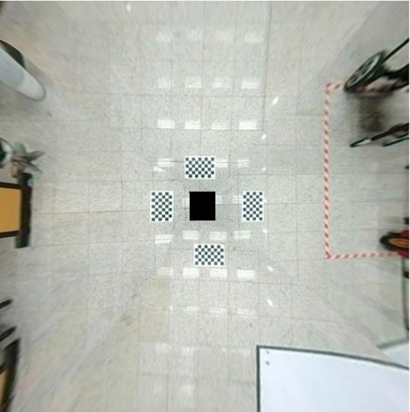
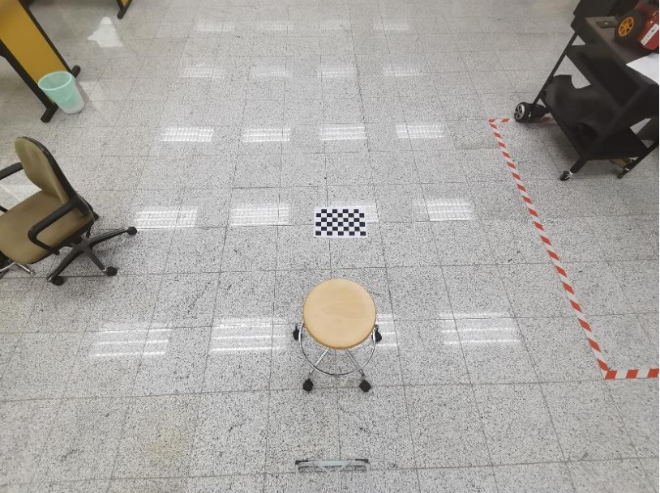
Validation Experiments – Birdseye View
Generated Birdseye Real overhead photo

Slide 31
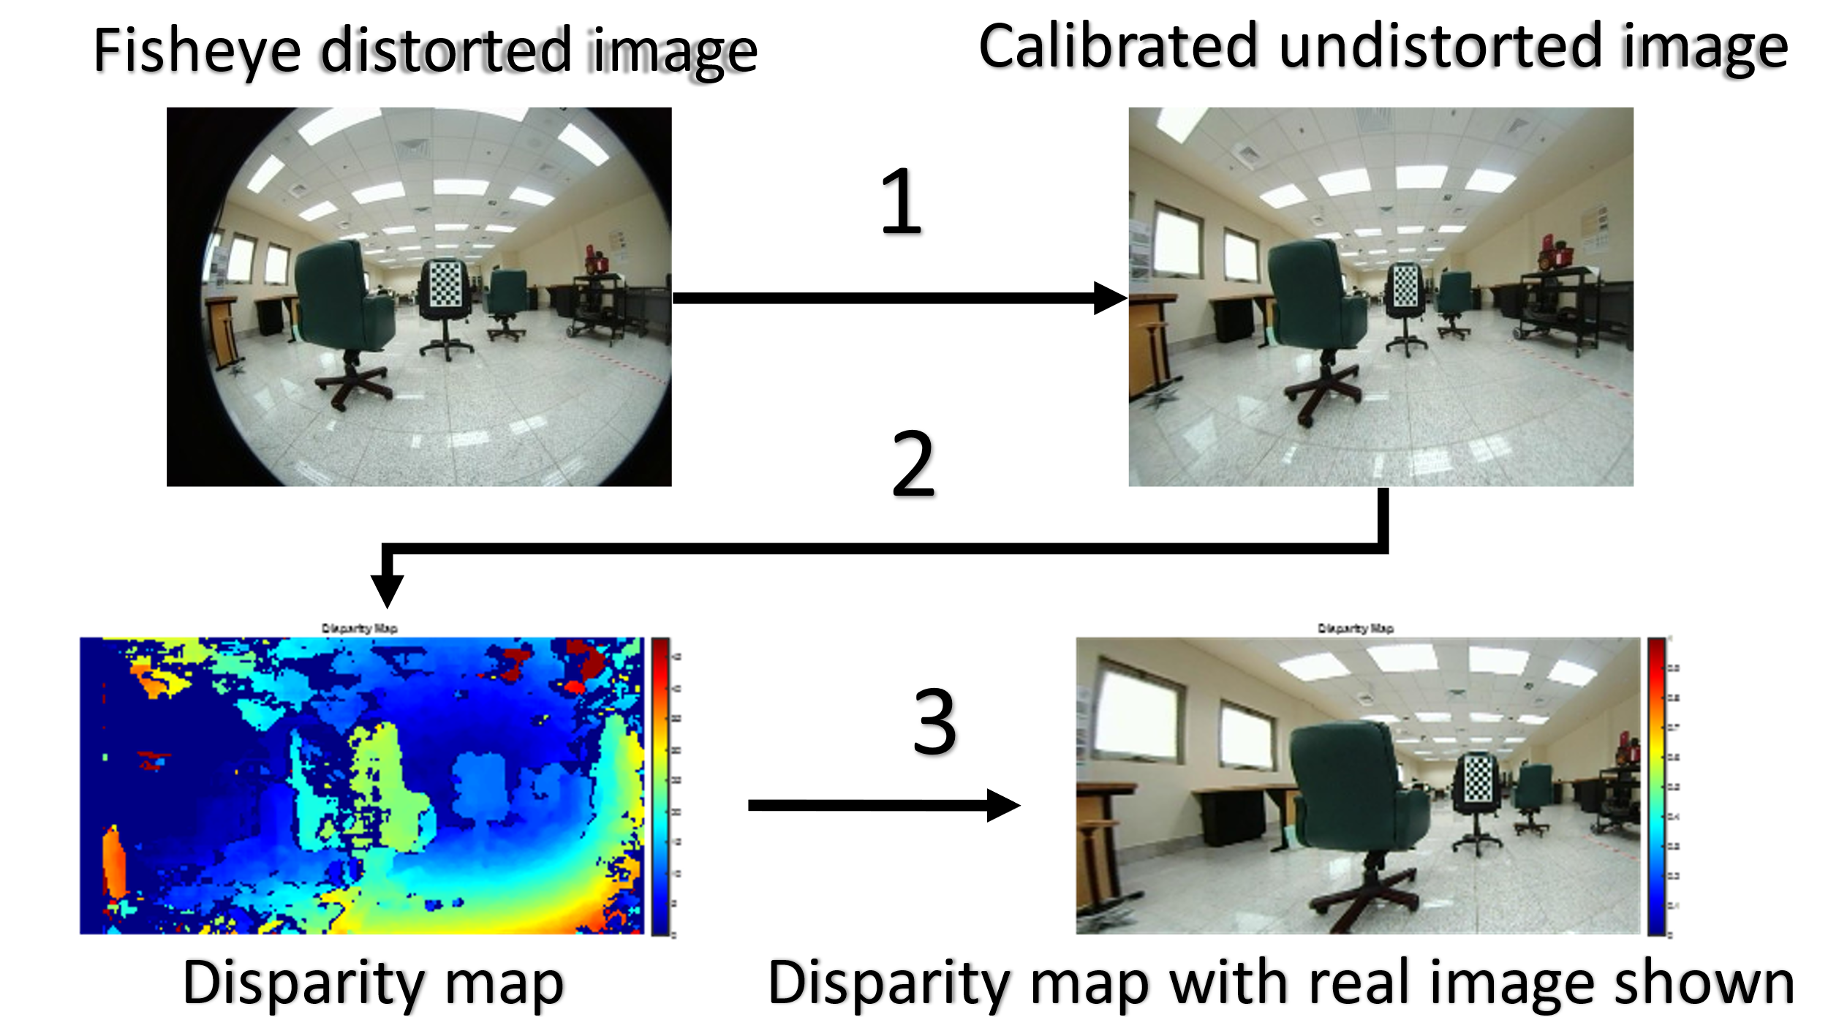
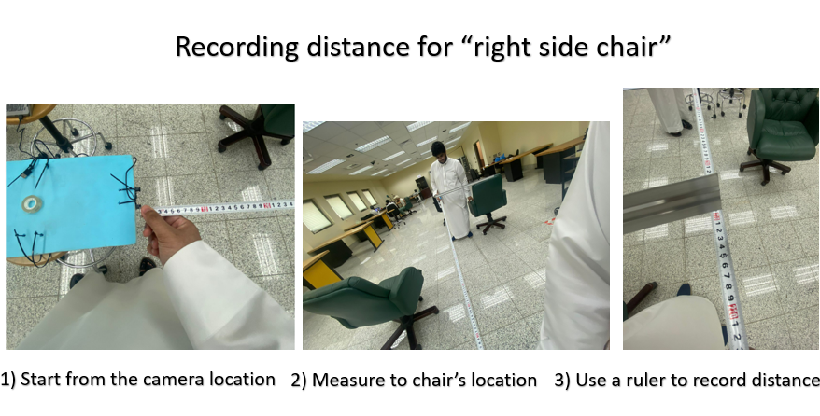
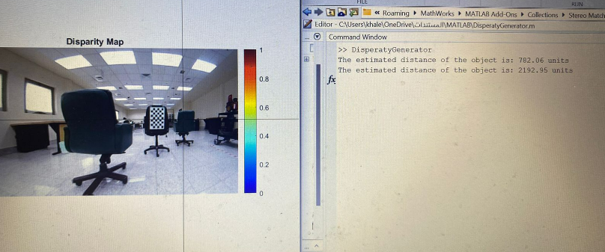
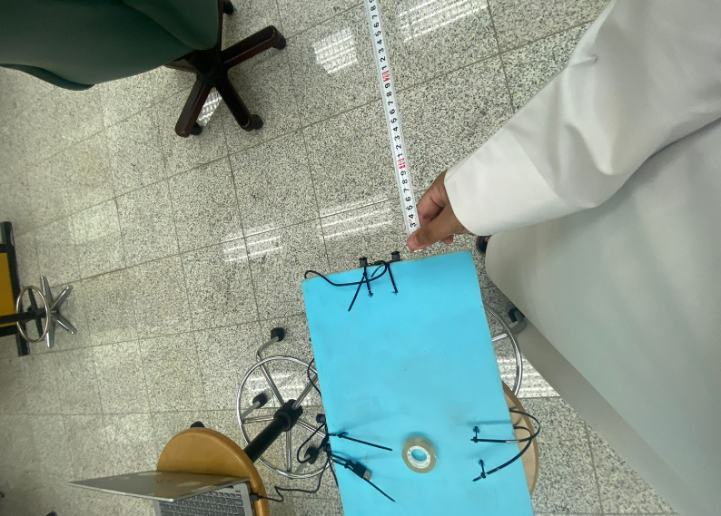
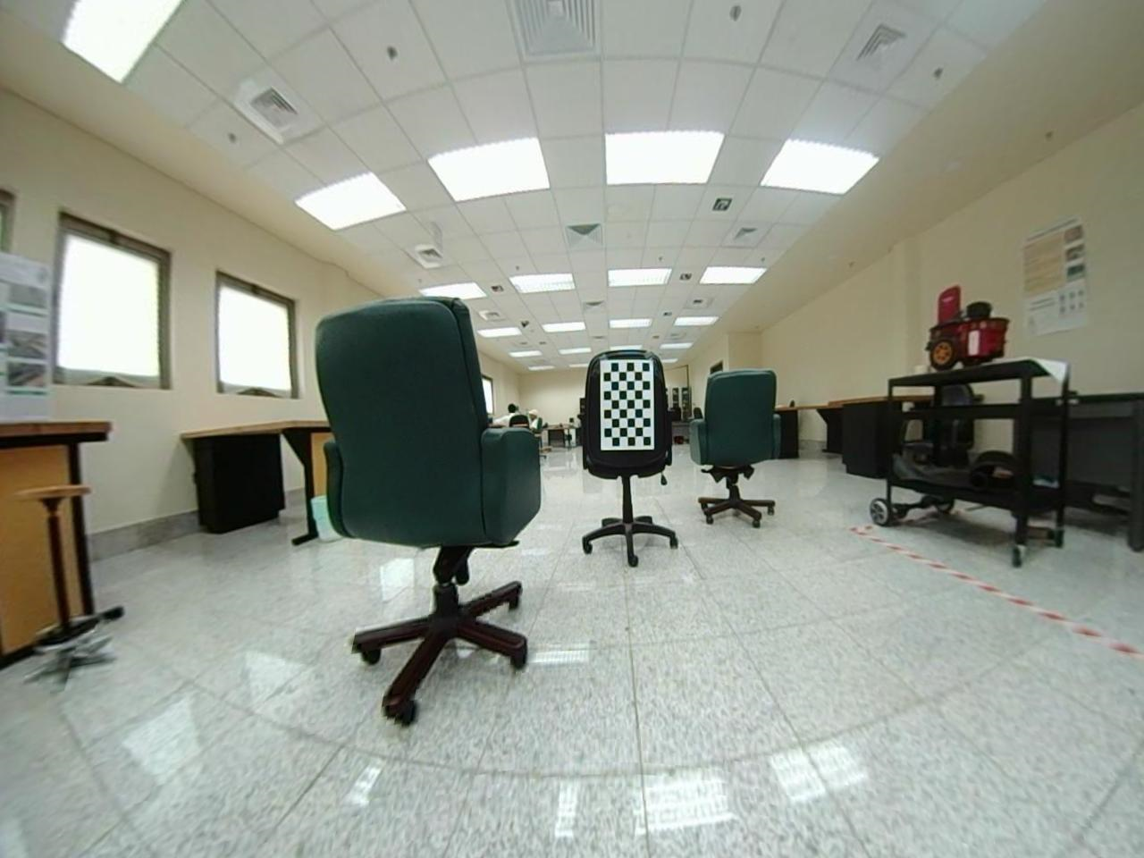
Validation Experiments – Distance Calculation
Program to test the distance calculation
The setting:
Table 4 Distances between the chairs and the camera represented in mm unit for comparison.
Object | Actual Distance (meters) | Calculated Distance (meters)
Left side chair | ≈ 78 cm = 780 mm | 782.06 mm
Right side chair | ≈ 210 cm = 2100 mm | 2192.95 mm
Chair with checkerboard | ≈ 170 cm = 1700 mm | 1783.27 mm

Slide 32
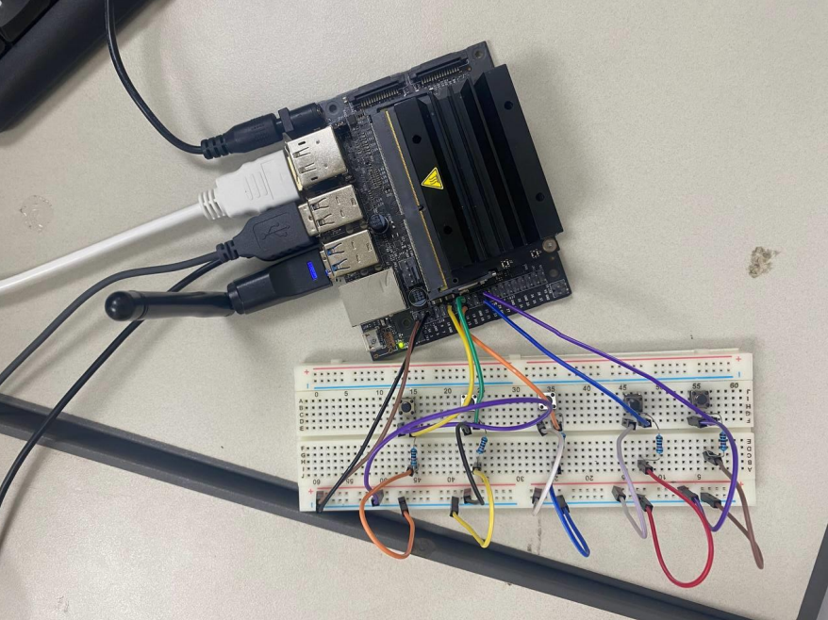
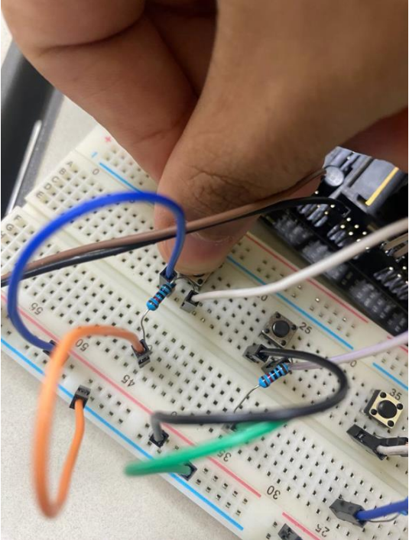
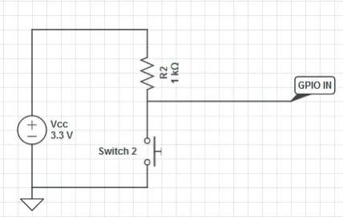
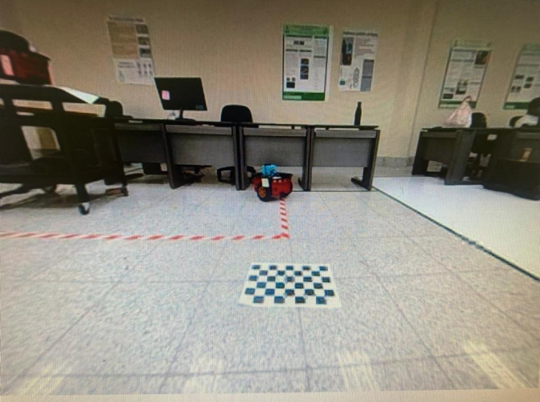
Validation Experiments – Jetson nano and pushbuttons
Pressing a button would show a different live feed of the cameras
The circuit

Slide 33
07
Implementation and final product

Slide 34
Implementation and final product
Hardware Implementation:
From the block diagram.
Software Implementation:
From the flow chart

Slide 35
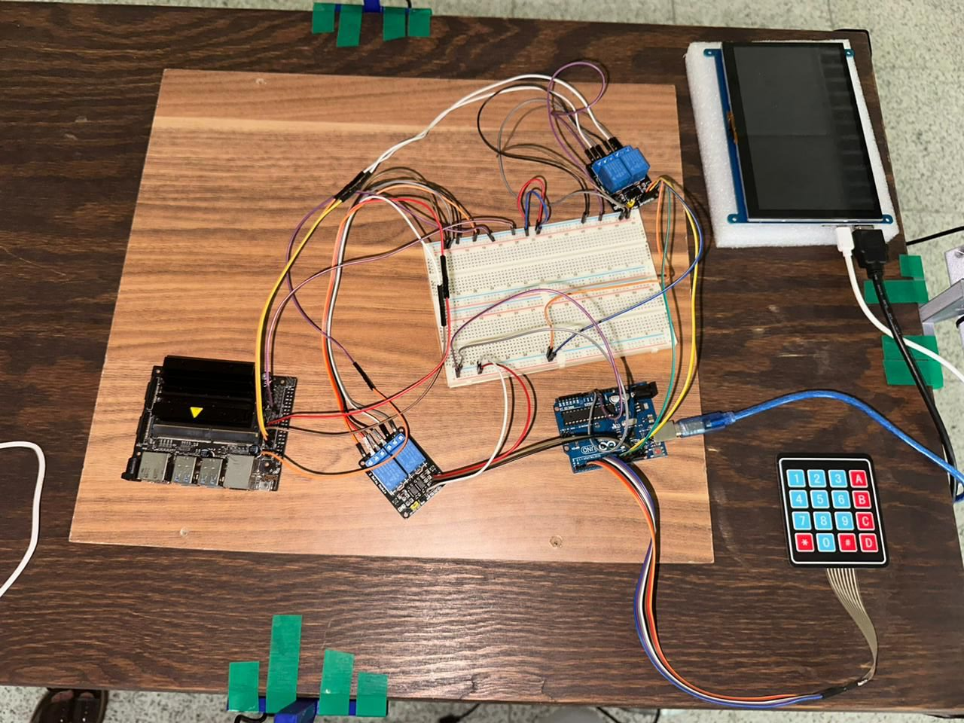
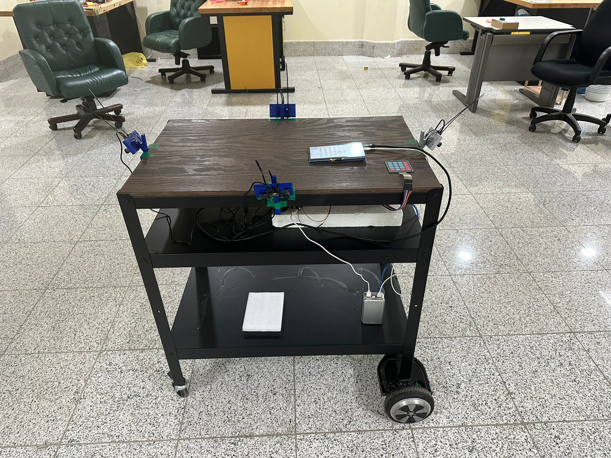
Hardware Implementation
Connection of Jetson nano with the screen and the input buttons
Placement of the four cameras on the prototype
Yolov3-tiny
Yolov3-tiny
Yolov3-tiny
Yolov3-tiny

Slide 36
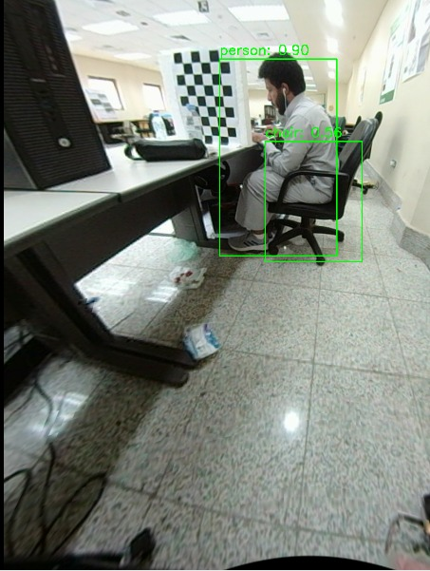
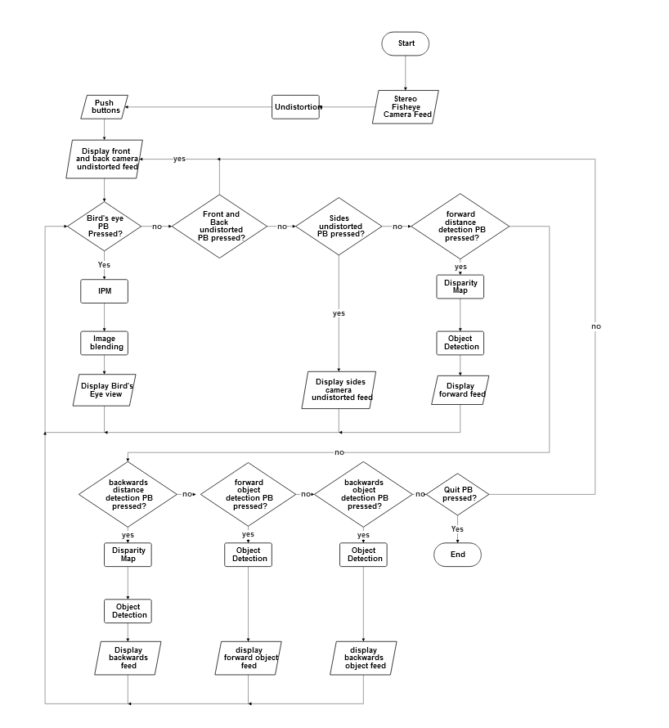
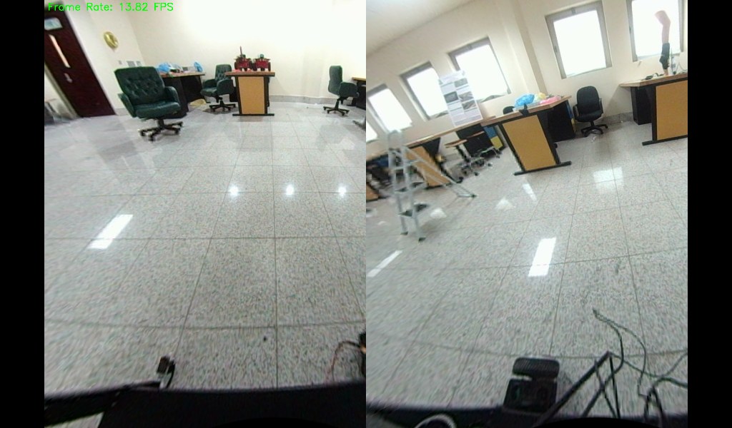
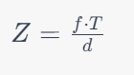
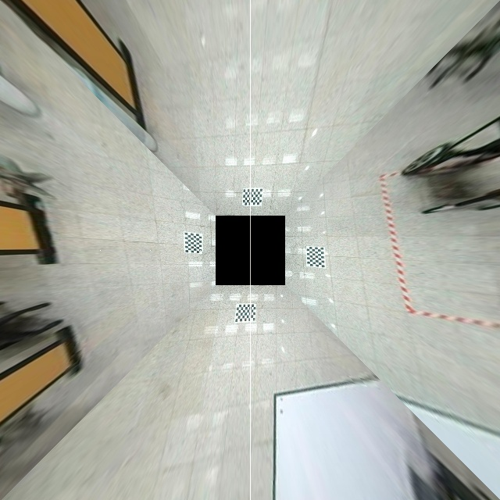
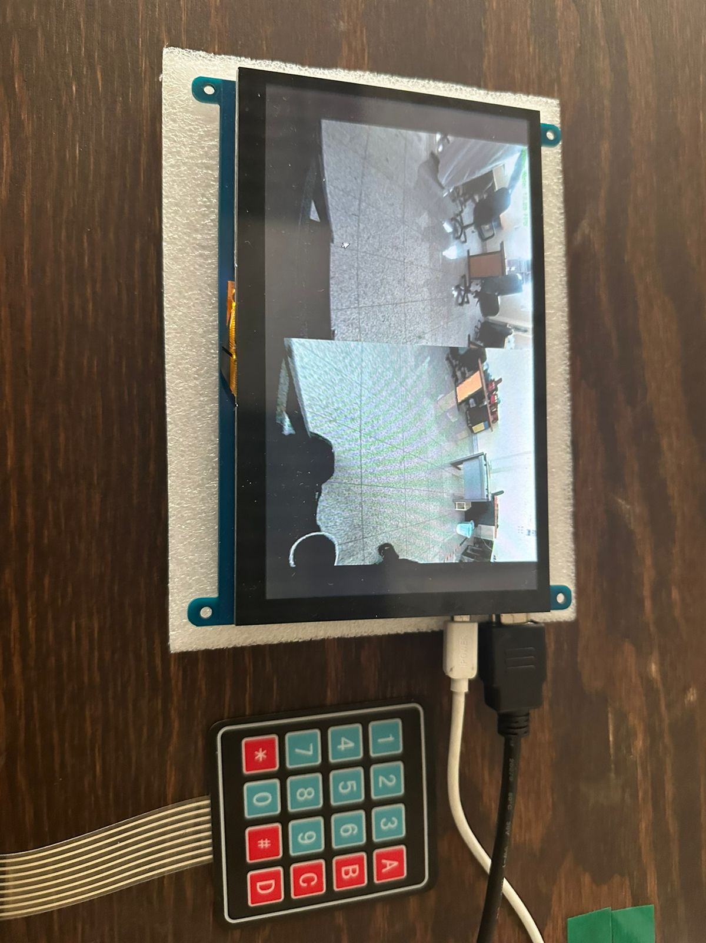
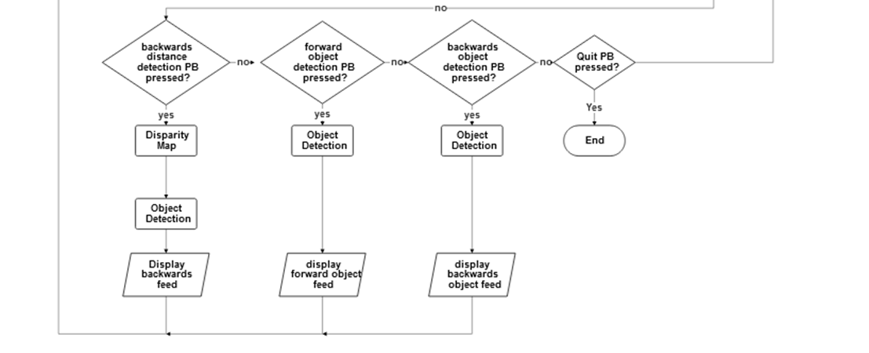
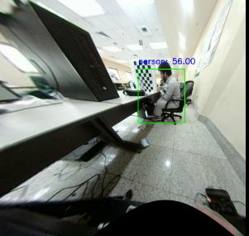
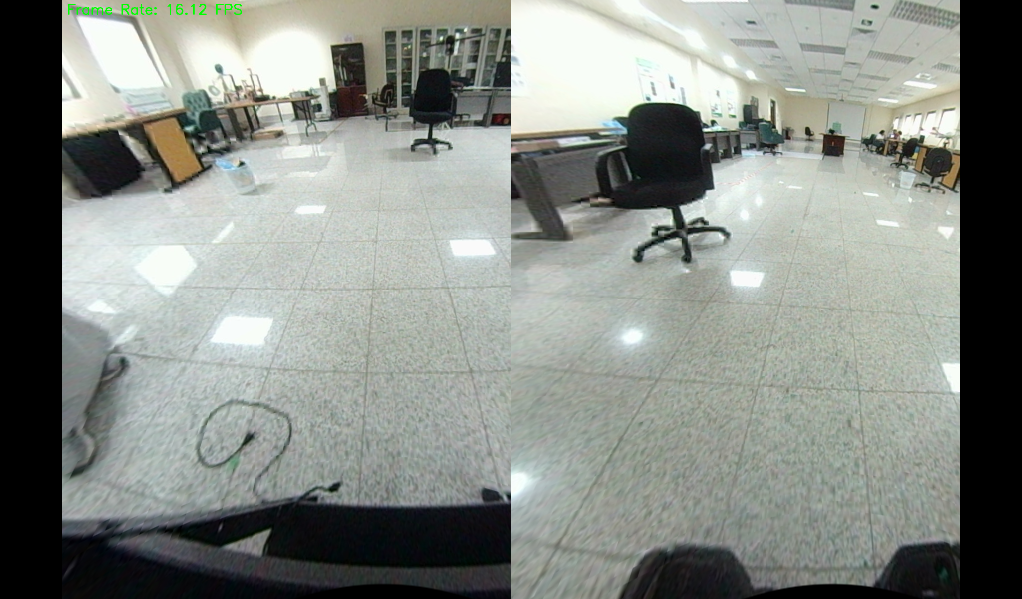
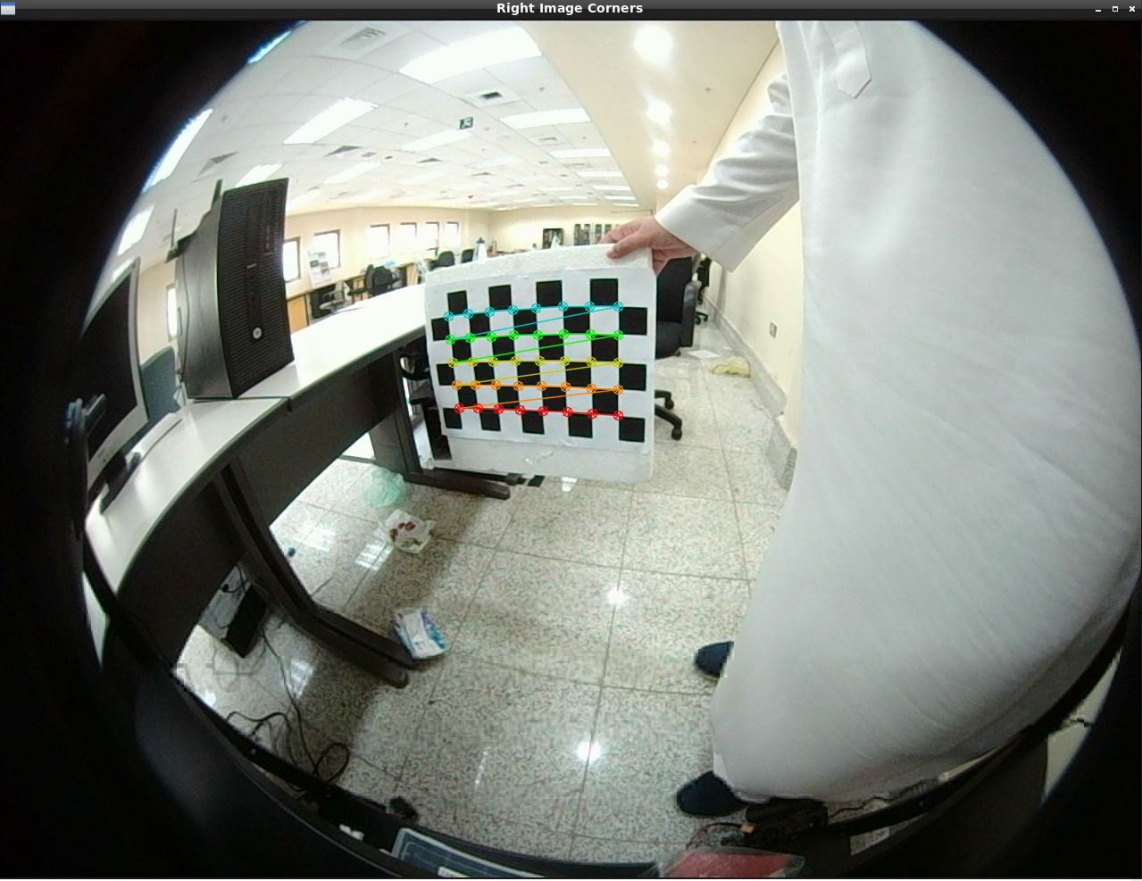
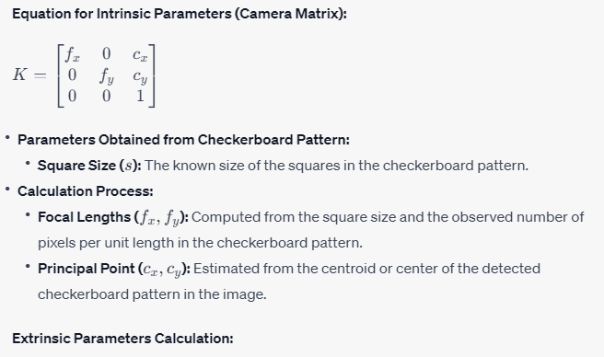
Software Implementation
Software interface is the keypad connected to the Jetson nano
Flow Chart of the software and its output
Intrinsic and extrinsic of the camera achieved by camera calibration are used to undistort the image.
x' = (u - c_x') / f’_x
y' = (v - c_y') / f'_y
Then a pixel map is generated to remap the picture either for rectification or undistortion using IPM
07
Validation Experiments
Notes:
Where:
u, v represent coordinates in the destination (corrected and rectified) image.
f'_x, f'_y denote the focal lengths of the intrinsic camera matrix.
c'_x, c'_y signify the principal point coordinates of the intrinsic camera matrix.
3D-2D Correspondences: Known 3D coordinates of corners in the checkerboard pattern (world coordinates) and their corresponding 2D locations in the images (image coordinates).
Square Size (s): The known size of the squares in the checkerboard pattern.
Calculation Process:
Pose Estimation (PnP): Solving the Perspective-n-Point (PnP) problem using the known 3D-2D correspondences and square size.
Rotation Matrix R and Translation Vector t: Determined from the relative orientation and position of the camera concerning the checkerboard pattern.
Parameters Obtained from Checkerboard Pattern:
Square Size (s): The known size of the squares in the checkerboard pattern.
Calculation Process:
Focal Lengths (fx​,fy​): Computed from the square size and the observed number of pixels per unit length in the checkerboard pattern.
Principal Point (cx​,cy​): Estimated from the centroid or center of the detected checkerboard pattern in the image.

Slide 37
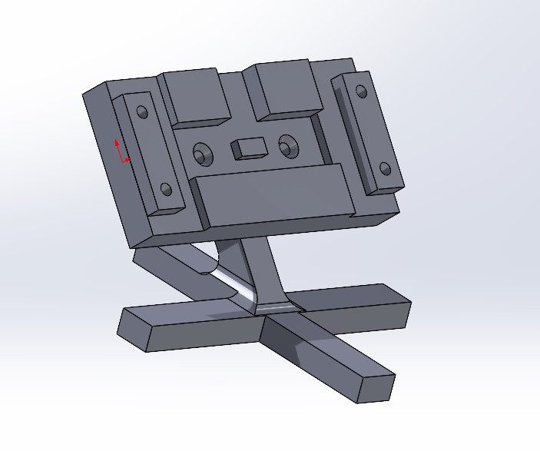
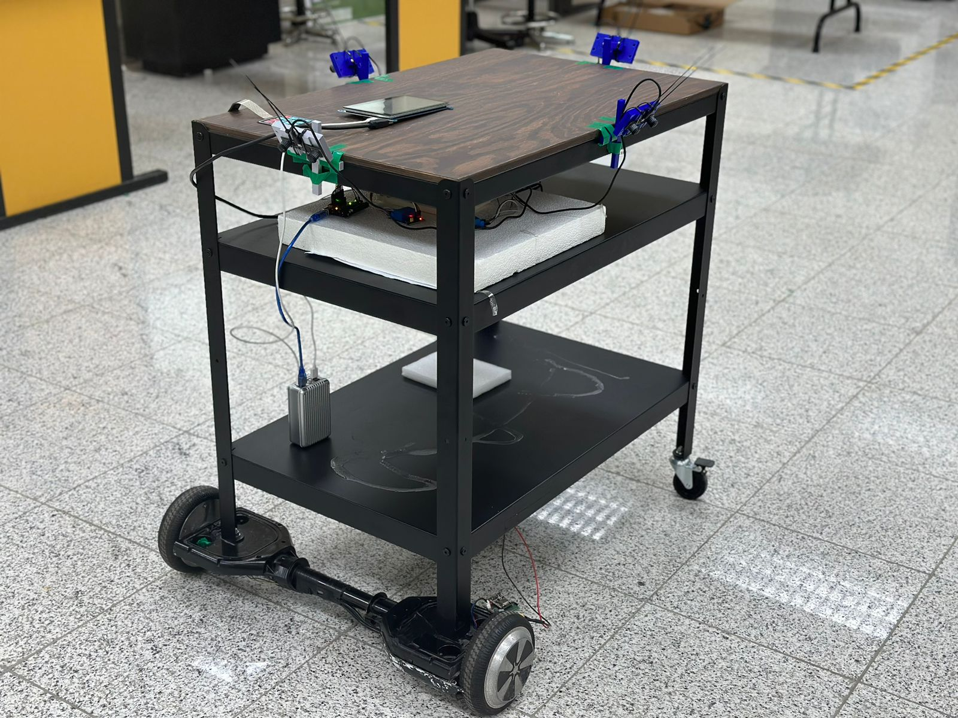
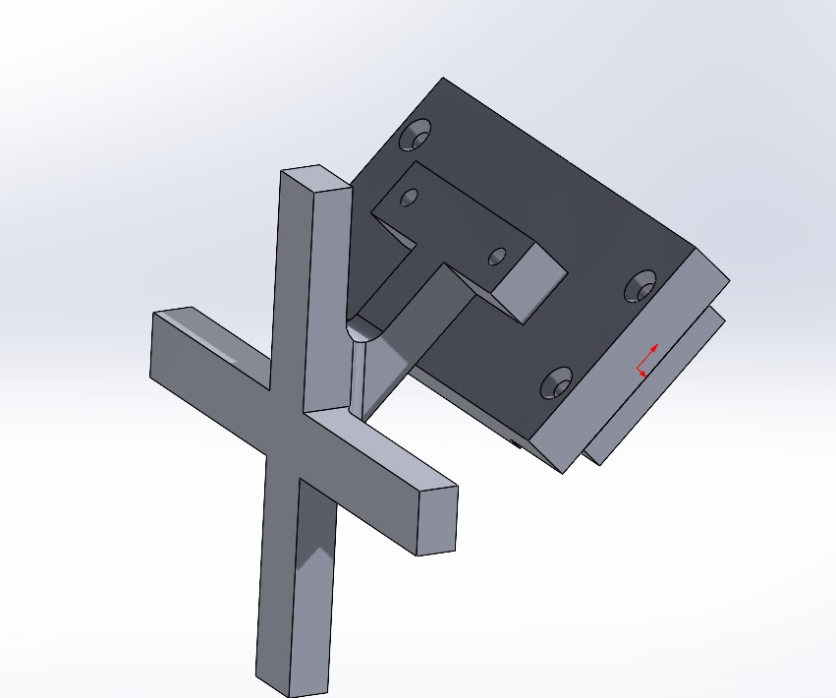
Final Prototype
* The prototype vehicle is not part of the project, its only used for demonstration and was provided by CEIEIS robotics lab.
3D printed stands for the cameras were made and used
07
Validation Experiments

Slide 38
08
Results

Slide 39
Results
Our results validate that our project has fulfilled the customer's specified requirements through a series of tests conducted within possible constraints:
Provide a distortion-free visual feed with at least 81° vertical field-of-view, covering the vehicle’s blind spots
Provide a user-friendly visual to depict the respective distances of surrounding objects with an accuracy of at least 90%.
Provide a bird’s eye view for 3 meters around the vehicle to assist while parking in tight spots and parallel parking.
Visual updates should be at least at 10 fps for a flicker-free, smooth, and comfortable view.

Slide 40
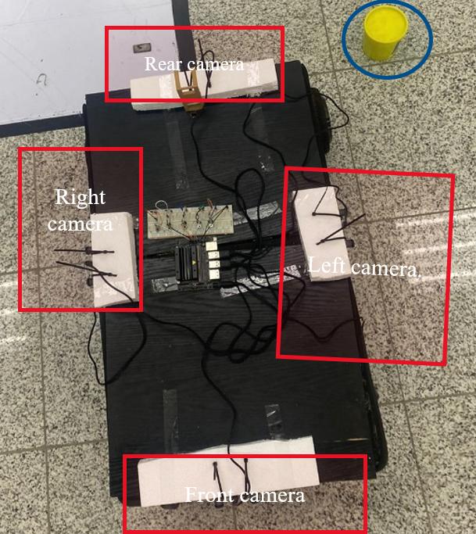
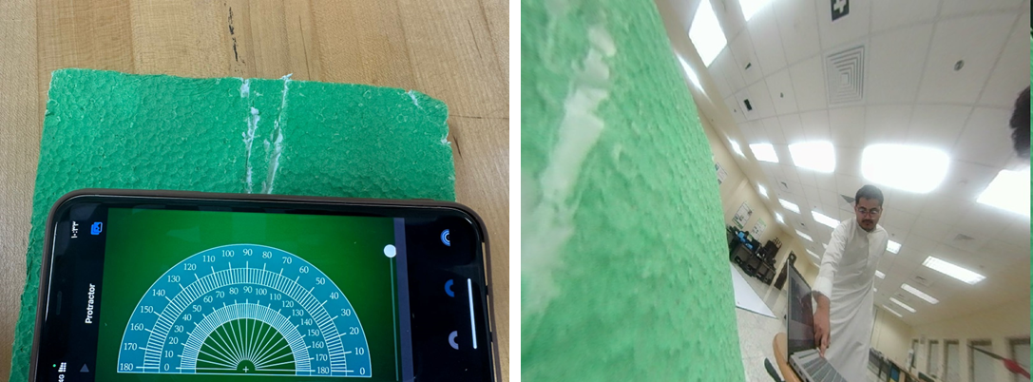
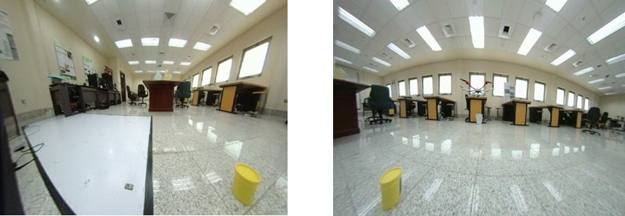
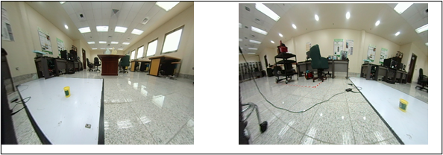
Results – covering the blind spots
The Setting:
Rear and left cameras corner
Rear and left cameras corner
Front and right cameras corner
Front and left cameras corner
Experiment to check if the camera can see up to 81° vertical field-of-view

Slide 41
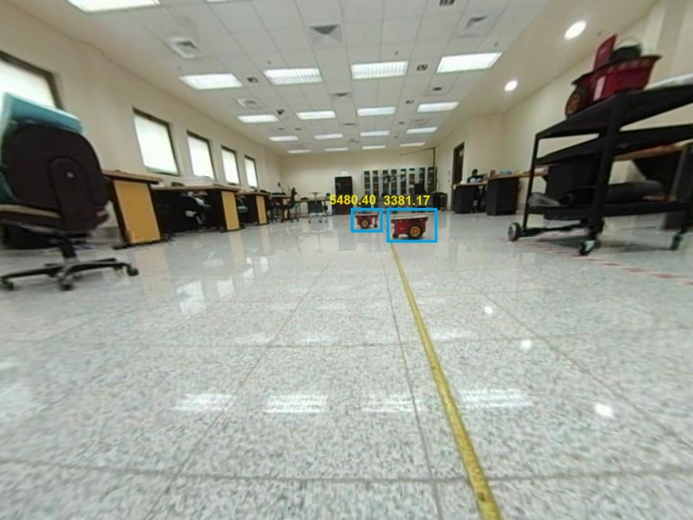
Results – Distance within 90% accuracy
The Setting:
Distance of the two objects measured at 320 cm and 500 cm respectively

Slide 42
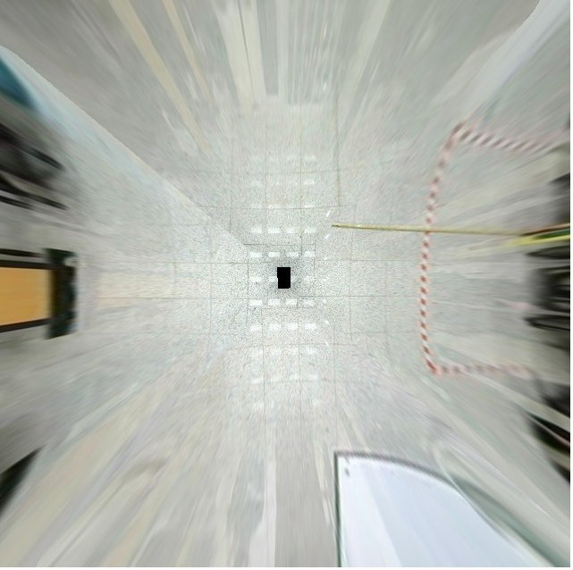
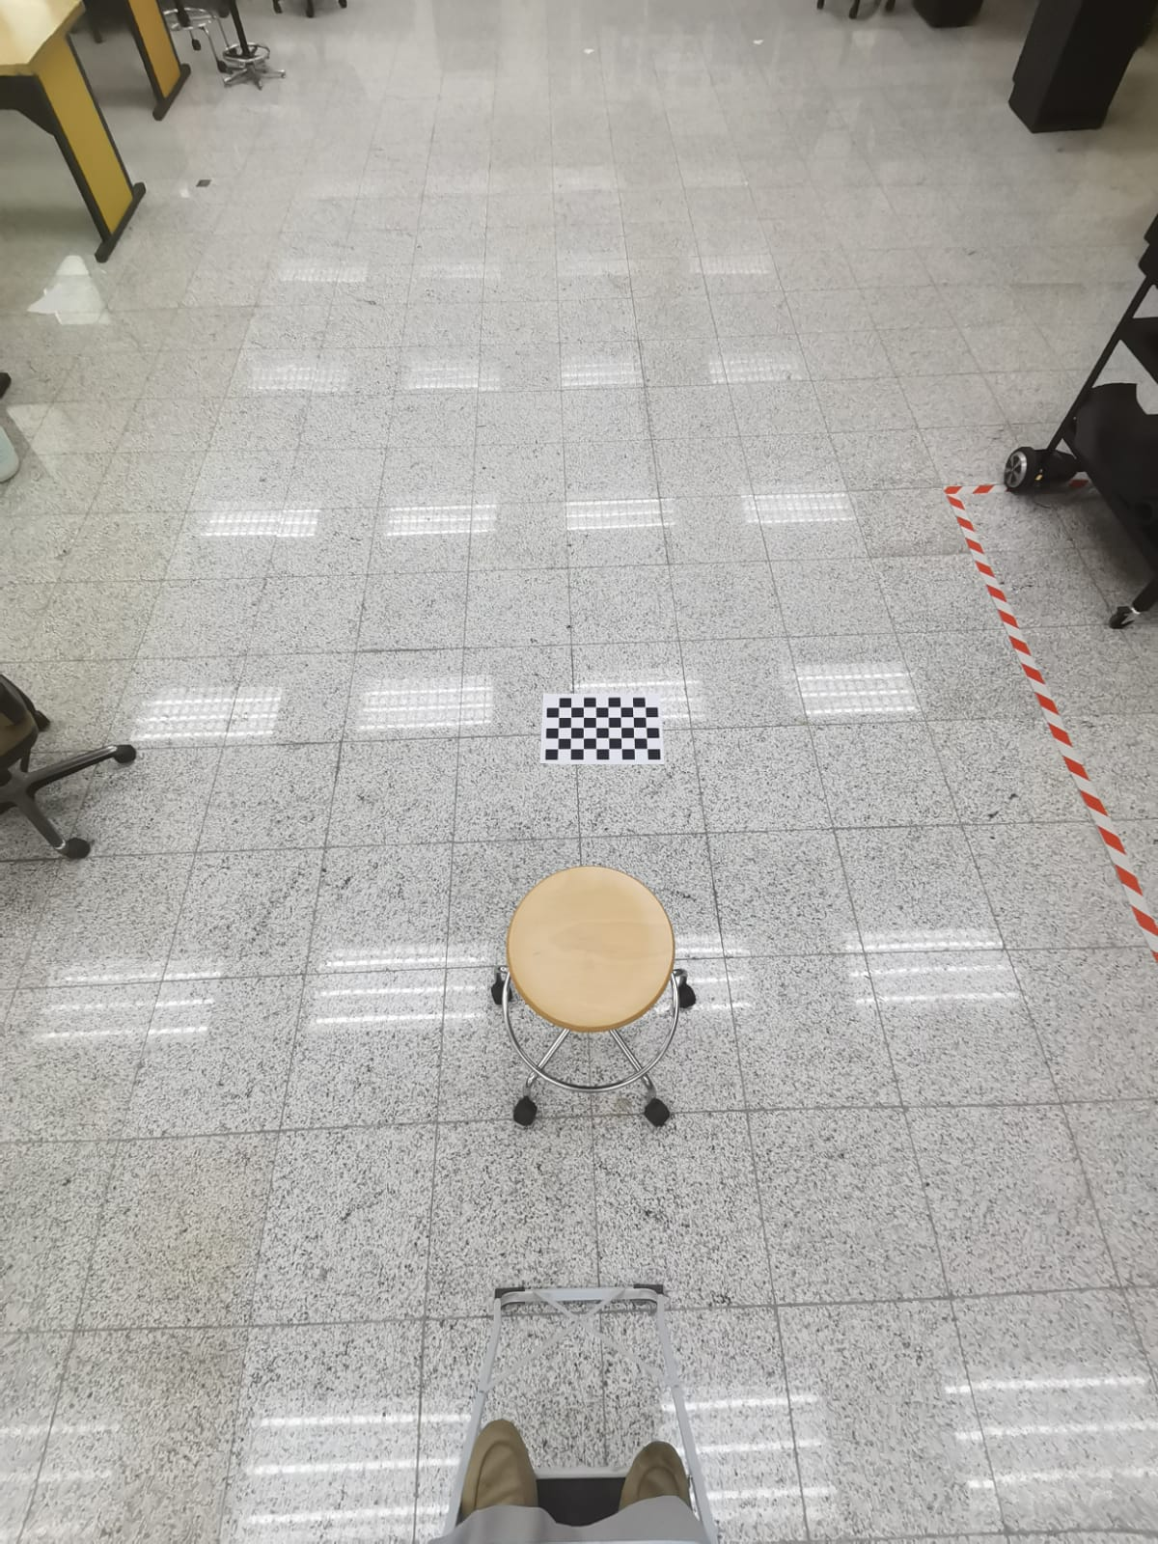
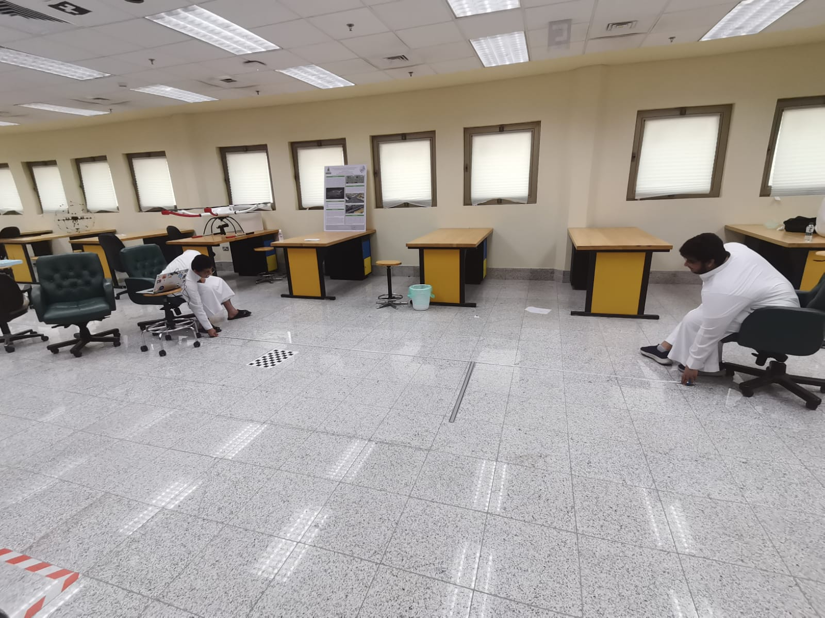
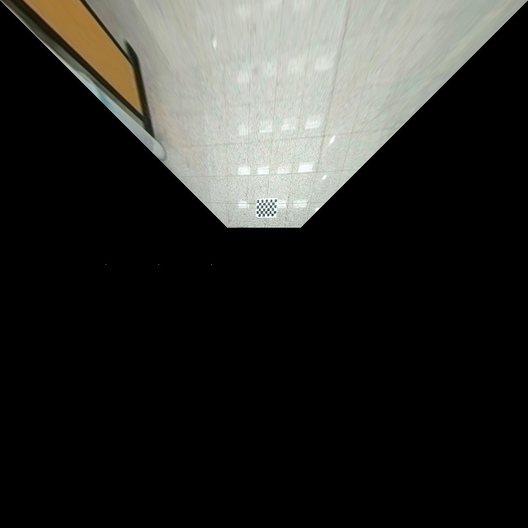
Results – Birdseye within 3 meters
At first, we verified that the Bird’s Eye view is generated accurately
Then we took a wide-angle image from above to see how the Bird’s is supposed to look.
And finally, we measured the distance the Bird’s Eye View covers.
3 Meters line

Slide 43
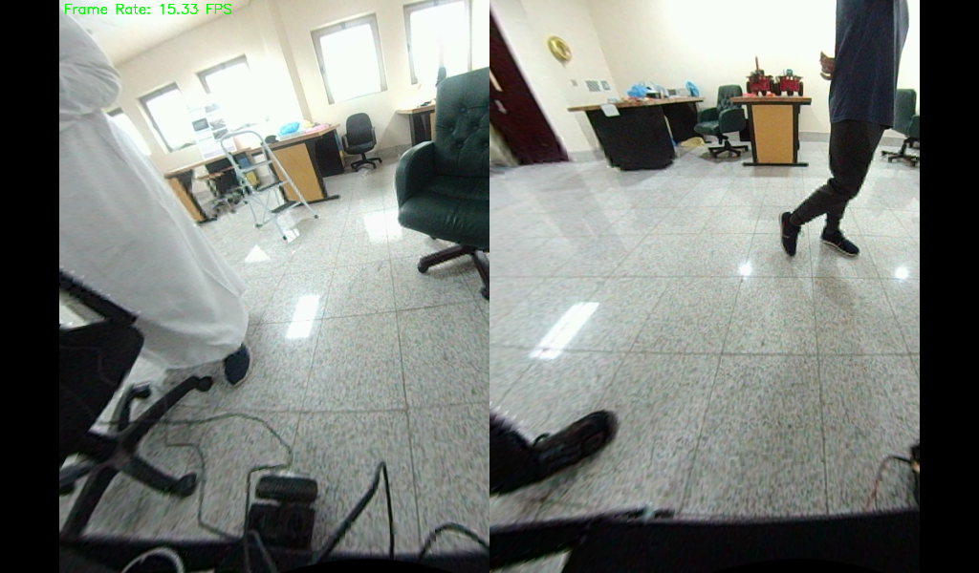
Results – Flicker-free visual feed
A code snippet was written to calculate how many frames per second gets displayed, that resulted in a minimum of 10 and a maximum of 15

Slide 44
Results – Flicker-free visual feed
A code snippet was written to calculate how many frames per second gets displayed, that resulted in a minimum of 10 and a maximum of 15

Slide 45
Results – Flicker-free visual feed
09
Impact analysis

Slide 46
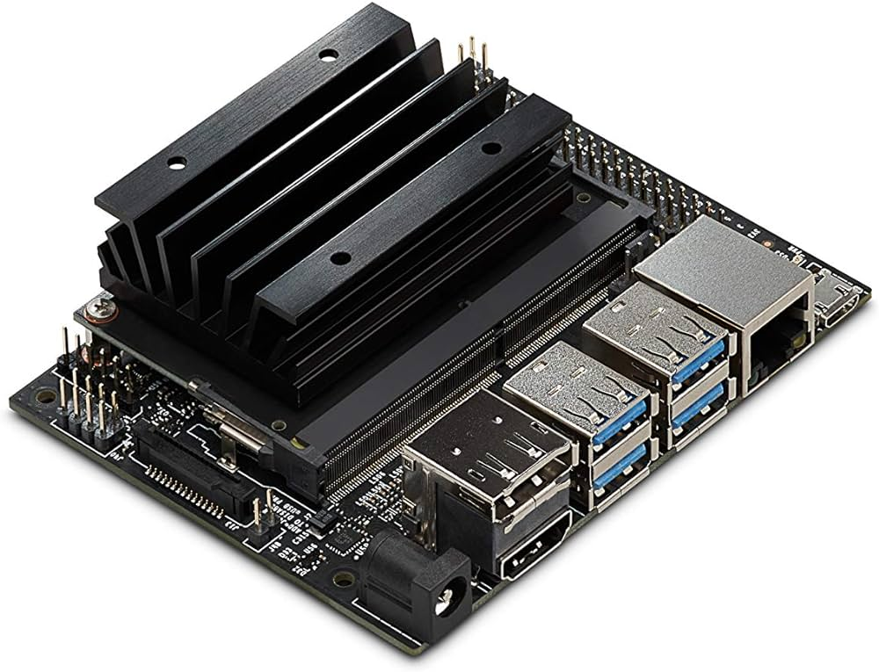
09
Impact analysis

Slide 47
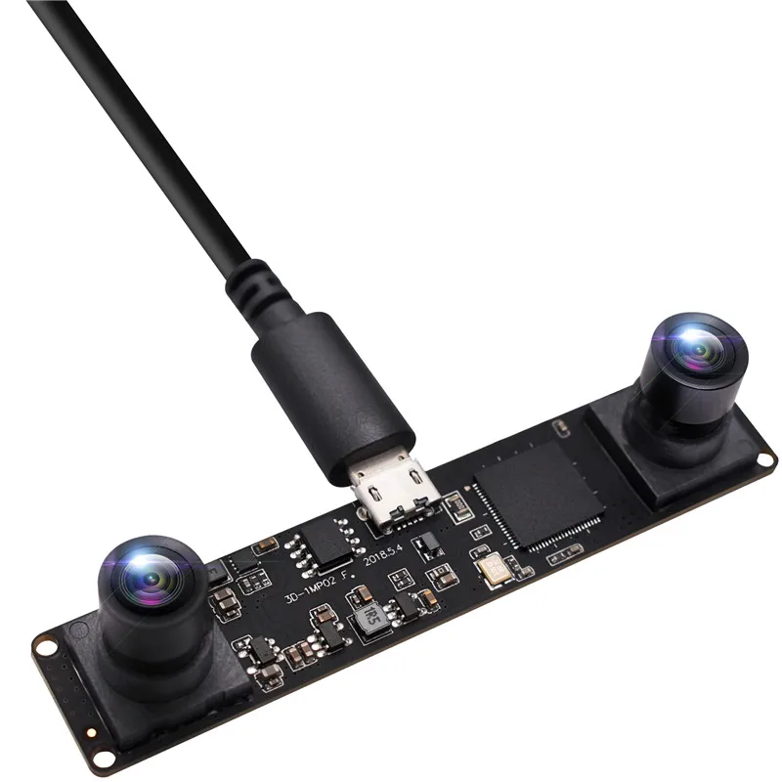
Environmental Impact
Jetson Nano
The Jetson Nano, with a low 5-watt power consumption and no need for a fan, has a comparatively modest environmental impact compared to a PC. Its open-source design facilitates easy repurposing and component reuse for various projects, enhancing sustainability.
Jetson Nano [4]

Slide 48
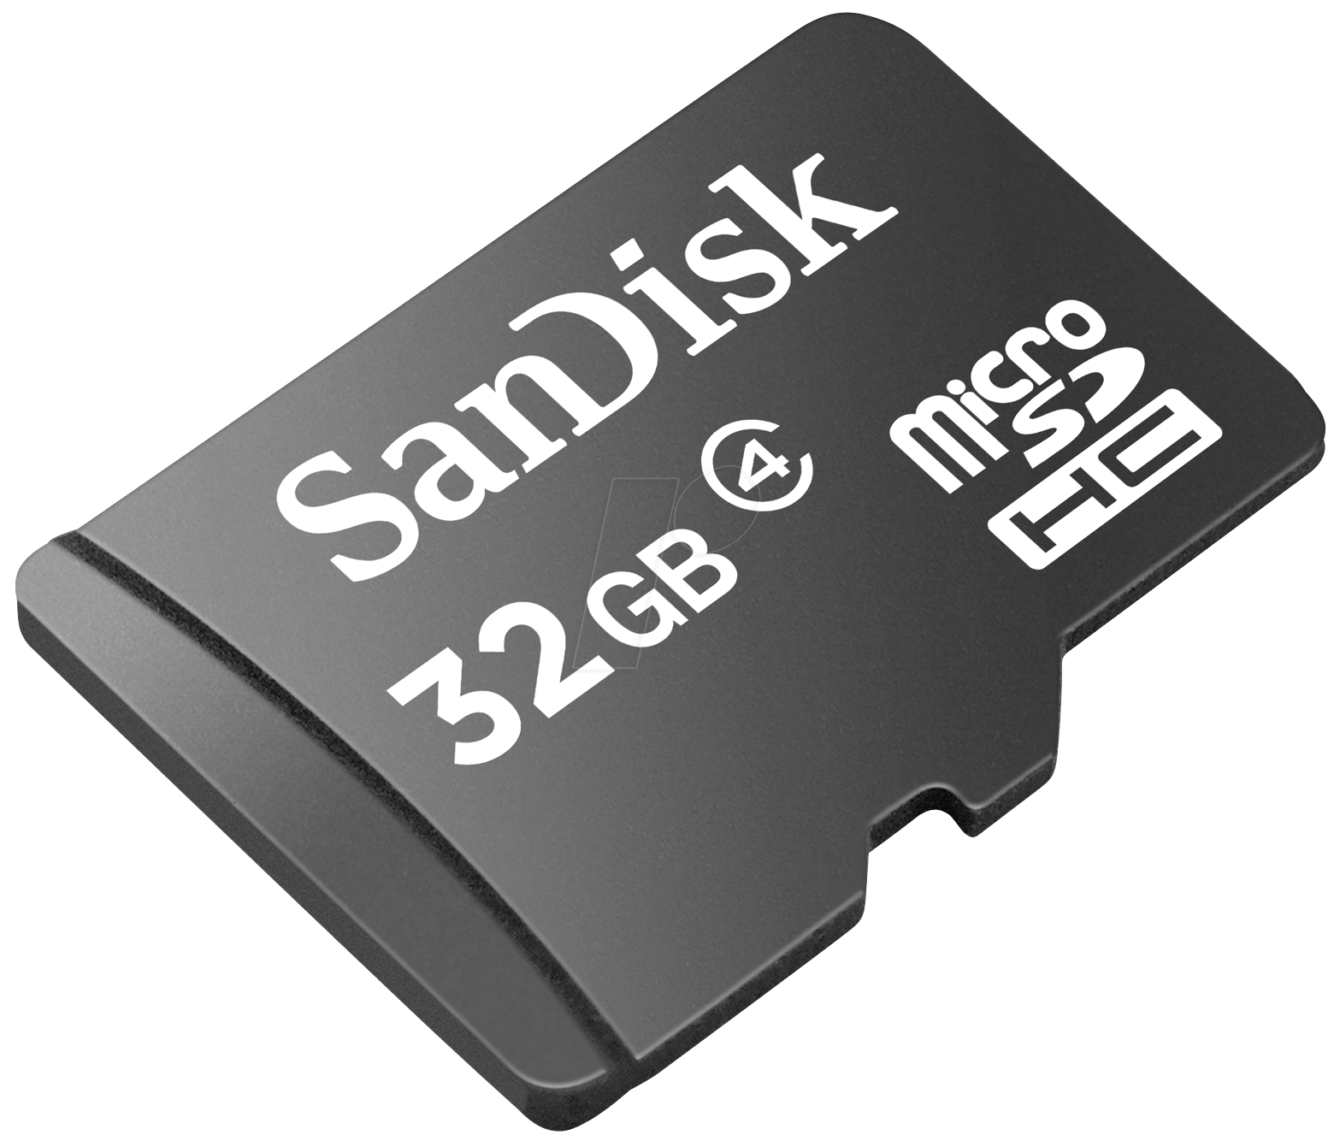
Environmental Impact
Stereo Wide-Angle Cameras
Wide-Angle stereo cameras, with their specialized materials and components, contribute to increased power consumption and environmental effects. However, their overall impact can be mitigated if used in an environmentally conscious manner, such as connecting them to a renewable energy source.
Ov9750 Wide-Angle Stereo Camera [5]

Slide 49
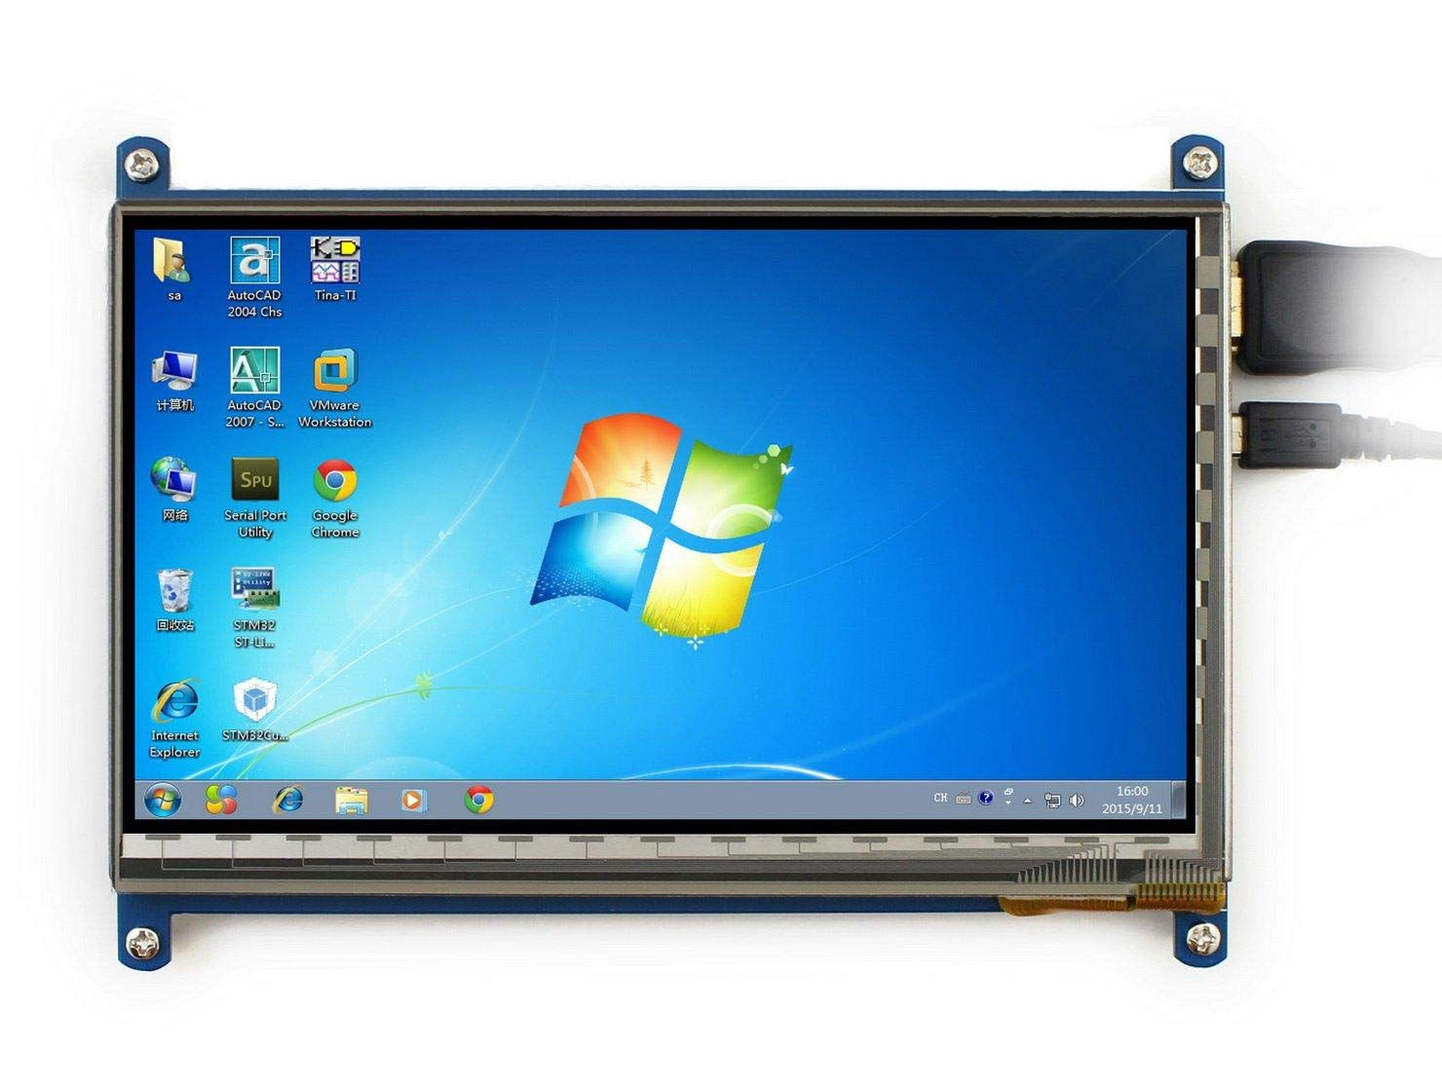
Environmental Impact
SD Memory Cards
SD memory cards pose an environmental challenge as they are crafted from non-renewable materials, predominantly plastic and metal extracted from the earth, contributing to pollution and resource depletion. To minimize their impact, recycling used SD cards becomes crucial, allowing for the reuse of materials and reducing waste.
32 GB SanDisk SD Memory [6]

Slide 50
Environmental Impact
Screens
Screens, prevalent in digital devices, amplify environmental impact through heightened energy consumption and demand for precious metals. Disposing of these devices releases toxic substances, polluting water, land, and air. Mitigating this impact involves adopting energy-efficient screen-based technology and using screens made from recycled or recyclable materials, curbing e-waste production.
TFT Screen [7]

Slide 51
Societal Impact
Significant impact on road safety through obstacle detection.
Prevention of collisions leading to a decrease in accidents.
Potential to save lives and reduce the financial burden on society.
10
Conclusion

Slide 52
10
Conclusion

Slide 53
Conclusion
Our project successfully provides a distortion free feed with at least 81° V-FOV of around 10 to 15 fps that is smooth and viewed comfortably. It also provides a user-friendly visual to depict the respective distances of surrounding objects within a 23-meter radius with an accuracy of at least 90%. It also provides a bird’s eye view for 3 meters around the vehicle to assist while parking in tight spots and parallel parking. And it also provides a segmented view of all objects. All with of that is controlled with comfort and ease using a keypad.

Slide 54
Conclusion
Notes:
We’re proud of the progress we’ve made in our project, we would like to thank Dr. Muhammad Bilal for guiding us with his expertise. We would also like to thank the Center of Excellence in Intelligent Engineering Systems. Led by Dr. Mohammed Abduaal for providing an ideal environment for innovation and growth.

Slide 55
References
[1] J. Shepard, “The role of Adas sensors in Automotive Design,” Microcontroller Tips. [Online]. Available: https://www.microcontrollertips.com/the-role-of-adas-sensors-in-automotive-design-faq/. [Accessed: 01-Mar-2023].
[2] “Camera calibrator,” MATLAB & Simulink. [Online]. Available: https://www.mathworks.com/help/driving/ug/create-360-birds-eye-view-image.html. [Accessed: 01-Mar-2023].
[3] “What is a car blind spot and how to check it,” Learn Automatic, 02-Mar-2021. [Online]. Available: https://www.learn-automatic.com/tutorials/observation-and-mirrors/car-blind-spot-and-how-to-check/. [Accessed: 01-Mar-2023].
[4] “Jetson Nano Developer Kit,” NVIDIA Developer, https://developer.nvidia.com/embedded/jetson-nano-developer-kit (accessed Nov. 15, 2023).
[5] “1.3 Megapixel 960p OmniVision OV9750 USB dual lens USB synchronized stereo camera webcam for 3D VR system,” 1.3 Megapixel 960p Omnivision Ov9750 Usb Dual Lens Usb Synchronized Stereo Camera Webcam For 3d Vr System - Buy Webcam,Webcam,Stereo Camera Product on Alibaba.com, https://www.alibaba.com/product-detail/1-3-megapixel-960P-OmniVision-OV9750_60176783227.html (accessed Nov. 15, 2023).
[6] “Secure Digital, SD Card PNG image with transparent background,” pngimg.com, https://pngimg.com/image/64256 (accessed Nov. 15, 2023).
[7] “7 inch TFT LCD Touch Screen Module HDMI 1024x600 RGB display board for Raspberry Pi and Arduino : Buy Online at best price in KSA - Souq is now Amazon.sa: Electronics,” 7 inch TFT LCD Touch Screen Module HDMI 1024x600 RGB Display Board for Raspberry pi and Arduino : Buy Online at Best Price in KSA - Souq is now Amazon.sa: Electronics, https://www.amazon.sa/-/en/Screen-1024x600-Display-Raspberry-Arduino/dp/B07NTTT5HH (accessed Nov. 15, 2023).

Slide 56
Thanks!
Do you have any questions?

